Slide 1
Proiect Python Training AirAssist

Slide 2
Aplicație de Claim Management – Conform EU261/2004 AIR-ASSIST
Propunere aplicație | Java Training2024
Regulamentul (CE) nr. 261/2004 al Parlamentului European și al Consiliului din 11 februarie 2004 de stabilire a unor norme comune în materie de compensare și de asistență a pasagerilor în eventualitatea refuzului la îmbarcare și anulării sau întârzierii prelungite a zborurilor
Cazuri acoperite:
- Întârzieri de zbor
- Anulări de zbor
- Refuz de îmbarcare
Se aplică la zboruri:
- EU <> EU – orice companie aeriană
- EU -> non-EU – orice companie aeriană
- EU <- non-EU – numai companii aeriene europene
Nivelul de compensație – dacă se datorează din vina companiei aeriene:
- <1500km – 250€
- 1500-3500km – 400€
- >3500km – 600€

Slide 3
Valoarea adăugată pentru pasager
Propunere aplicație | Java Training2024
Pasager
Pasager
Airline
Avocat
Air-Assist

Slide 4
Cum ajunge pasagerul în aplicație
Propunere aplicație | Java Training2024
Marketing Funnel
Social Media
SM Ads
Google Ads
Email marketing
CALL TO ACTION
Landing Page
Information
Knowledge
CALL TO ACTION
No Sign up
Signed up
Case verification form
Example HERE
Case management
From eligibility verification to case closure
Airline
Passenger
Air-Assist

Slide 5
Procesul de compensare (conform EC261/2004)
Propunere aplicație | Java Training2024
1.
Înregistrare caz
2.
Verificare zbor
3.
Verificare Av.
4.
Airline
5.
Închidere caz
Pasager/Pers. Aut.
Angajat AA
Angajat AA / Avocat
Angajat AA
Angaja AA / Pasager
Verificare eligibilitatea formală:
Ruta
Zborul/data
Airline EU/non-EU
Tip eveniment
Motiv (conf. pasager)
Dacă OK – înregistrare caz – generare contract PDF / user
Cerere documente:
Talon îmbarcare
Pașaport/ID
Corespondență
Verificare formală
Anulare (info<14d)
Întârziere (if >3h)
Verificare eligibilitate motiv:
Condiții meteo
Eurocontrol
Alte surse publice
Setare status corespunzător:
Eligibil VAA
Eligibil CC
Neeligibil
Flag zbor – eligibil pentru despăgubri:
data
#zbor
Se generează cererea de despăgubire (Word/PDF) adresată companiei aeriene cu toate datele necesare:
Distanța – nivel de comp.
Motiv – eligibilitate
Poate include mai multe pasageri
Se înregistrează caz de avocat și se trimite avocatului pentru verificare cererii de despăgubire – avocatul completează/reîncarcă
Cererea de despăgubire intră în corespondență* cu compania aeriană
Răspunsuri cu nevoia clarificării legale se vor atașa la cazul de avocat deschis
Se închide cazul și se comunică rezultatul
În caz de câștig:
Cerere detaliilor bancare ale PAX
Virament bancar
Emitere factură

Slide 6
Procesul de compensare (conform EC261/2004)
Propunere aplicație | Java Training2024
1.
Înregistrare caz
2.
Verificare zbor
3.
Verificare Av.
4.
Airline
5.
Închidere caz
Pasager/Pers. Aut.
Angajat AA
Angajat AA / Avocat
Angajat AA
Angaja AA / Pasager
Verificare eligibilitatea formală:
Ruta
Zborul/data
Airline EU/non-EU
Tip eveniment
Motiv (conf. pasager)
Dacă OK – înregistrare caz – generare contract PDF / user
Cerere documente:
Talon îmbarcare
Pașaport/ID
Corespondență
Verificare formală
Anulare (info<14d)
Întârziere (if >3h)
Verificare eligibilitate motiv:
Condiții meteo
Eurocontrol
Alte surse publice
Setare status corespunzător:
Eligibil VAA
Eligibil CC
Neeligibil
Flag zbor – eligibil pentru despăgubri:
data
#zbor
Se generează cererea de despăgubire (Word/PDF) adresată companiei aeriene cu toate datele necesare:
Distanța – nivel de comp.
Motiv – eligibilitate
Poate include mai multe pasageri
Se înregistrează caz de avocat și se trimite avocatului pentru verificare cererii de despăgubire – avocatul completează/reîncarcă
Cererea de despăgubire intră în corespondență* cu compania aeriană
Răspunsuri cu nevoia clarificării legale se vor atașa la cazul de avocat deschis
Se închide cazul și se comunică rezultatul
În caz de câștig:
Cerere detaliilor bancare ale PAX
Virament bancar
Emitere factură

Slide 7
Project Air-Assist.eu Claim Management App
Case entry
Eligibility check
Legal proceeding
Case closure
Passenger fills out dynamic form
Colleague checks eligibility of flight & case
Create claim case and request attorney for check + proceed with airlines
Colleague marks claim case
Formal validity is checked
If formal validity OK
Inform about potential compensation
Create case and id
Create PDF-contract
Notify and assign to colleague
If formal validity NOK
Reject costumer and CTA for new case
Flight and claim eligibility is checked
IF OK – automatic request for further documents AND flag flight as ELIGIBLE
IF NOK – automatic response to passenger of rejection AND flag flight as NON-ELIGIBLE
Create claim case
Mutliple cases cand be assigned to claim case IF:
For cases WITH same flight AND without connecting flights
For cases WITH connecting flights only with same reservation code
ELSE claim case only for one case
Create claim case and id
Create Word-payment request
Assign to attorney
Notify and assign to attornes
Notify colleague when attorney responded
Proceed with airlines outside application
Claim case is marked accoding to airline dispute result
IF WIN – automatic request for payment infromation to all passengers in linked cases
IF LOST – automatic response to passenger of rejection

Slide 8
Implementation details

Slide 9
Technologies to use
Backend with Django Framework (Python)
REST framework, authentication, authorization
Frontend with React
Database is PostgreSQL

Slide 10
USER TYPES
Passenger: registered and non-registered
Can create cases (both registered ad non-registered)
Can see past own cases (only registered)
Can attach & download documents to/from own cases
Can comment cases – as means of communication
Attorney
Can see claim cases
Can comment claim cases – as means of communication
Can attach documents to claim cases
Can see linked cases and flights to the claim cases
Can reassign cases to colleagues
Passengers
Attorneys
Colleague
Can create: cases, claim cases, flights
Can comment: cases, claim cases – as means of communication
Can create user account (only for passengers)
Can attach & download documents to/from case, claim case, and flights
Can link
Cases to claim cases
Flights to cases
Can assign
Cases to other colleagues
Claim cases to attorneys
System admin
Can create users: passengers, colleagues, attorneys
Can delete users: passengers, colleagues, attorneys, cases, claim cases, flights
Can modify/reset user accounts
Can change system options (email accounts/SMTP servers, email presets, pdf presets)
Colleagues
System admin

Slide 11

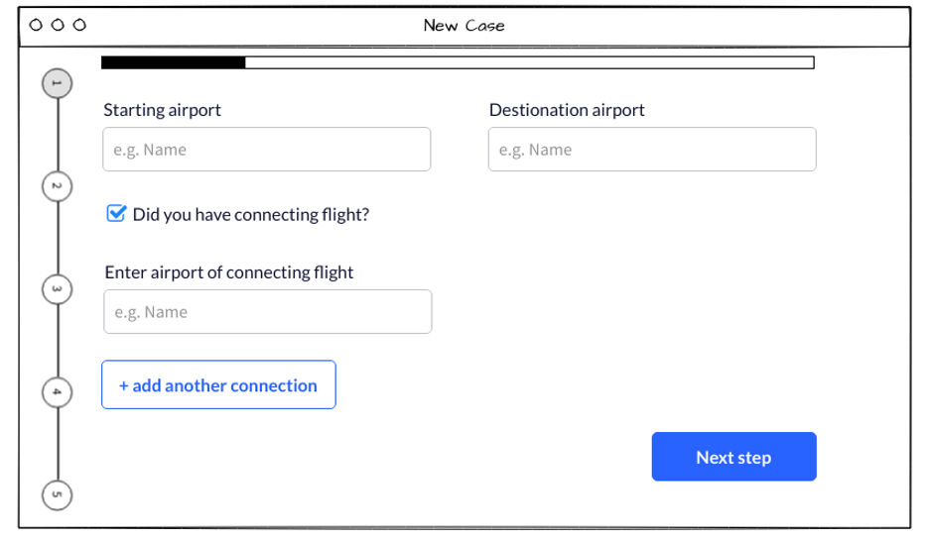
Entry form
Cases will be recorded with a dynamic entry form.
The form can be accessed publicly, without login.
The same form will be used for users with existing cases.
All field are required.
Design requirements:
Progress bar
Blue/green colors as accents – see logo
Flight itinerary
Starting and final airport
And connecting flights
Disruption details
Cancellation
Delay
Disruption motive
What was the reason?
Request email & compliance
Capture email address
Flight details
Generate case
Passenger details
Denied boarding
Selection and Tex fields
GDPR and T&C acceptance
Capture flight nr and date
Capture passenger addresses / contact details
Generate PDF
Send email with user details, contract and CTA

Slide 12
Entry form
Flight itinerary
In this step, we record the basic data for a case to determine the orthodromic distance between the starting point and final destination. This calculation determines the level of compensation
Starting airport (input variables with API call for correct airport)
Destination airport (input variables with API call for correct airport)
Direct flight or connecting flight/-s?
If connecting flight - enter connecting flights (ex. enter location)
Max. 4 connection or dynamic
Select connecting flight/-s, which was disrupted
List varieties of connecting flight, ex. a-b/b-c/c-d etc.
Make list selectable
Compensation level:
<1500km – 250€
1500-3500km – 400€
>3500km – 600€

Slide 13
Entry form
Disruption details
In this step, based on user input, we determine if the case is formally eligible.
Dynamic fields should be used. If any of the answer is not eligible: pop-up with sorry
What type of disruption?
cancellation
How late arrived to final destination? (<3h, >3h, never arrived)
ELIGIBLE: >3h OR never arrived
How many days before cancellation has the airline informed? (>14 days, <14 days, on flight day)
ELIGIBLE: <14 day OR on flight day
delay
How late arrived to final destination? (<3h, >3h, connection flight lost)
ELIGIBLE: >3h OR never arrived
denied boarding
How late arrived to final destination? (<3h, >3h, never arrived)
ELIGIBLE: >3h OR never arrived
Did you give up your seat voluntarily? (Yes/No)
ELIGIBLE: NO
If any of the answer is not eligible:
pop-up with sorry message
CTA to try another flight

Slide 14
Entry form
Disruption motive
In this step, based on user input, we determine the motive of the disruption. No validation required.
Disruption motive
For delay and cancellation
Did the airline mention disruption motive? (Yes/No/Idk)
If YES -> What was the motive communicated by the airline? (Technical problem, meteorological conditions, strike, problems with airport, other motives)
Describe in short what has happened (larges text box)
For denied boarding
Describe in short what has happened (larges text box)

Slide 15
Entry form
Request email & compliance
In this step, we request the e-mail address of the user and ask him to accept GDPR so we can process his data.
Request email & compliance
E-mail
GDPR disclaimer
GDPR acceptance checkbox

Slide 16
Entry form
Flight details
In this step, we request information about the flight.
Flight details
For each flight leg entered in section 1, the following data must be entered:
Flight date
Flight Nr
Airline
Reservation Number
Xxxxxx

Slide 17
Entry form
Passenger details
In this step, we request information about the user, so that we can create an account and contract for him.
Passenger details
Name
Family Name
Date of birth
Contact details: email, phone, address, postal code
Ask, if existing user - login if necessary to autofill details

Slide 18
Entry form
Generate case, PDF, email
In this step, we generate a Case in our system and generate a contract between the company and the passenger.
Generate case, PDF, email​
Case is created with ID and date
Flight disruption is created
PDF contract is created (case ID/date as contract nr/date, passenger details, reservation nr)
Automatic email with pdf to passenger and notification to employees

